Slide 1
KRISTY HEAD OF BIOGENICS 43yrs old
What do you want the world to know about HTLV?
That is exists!!!!
What do you wish you knew about HTLV before you were affected personally?
That it existed!!!!
What would you say to someone newly diagnosed?
There is a way forward. There is hope. You are not alone.
What do you wish all medical staff would know?
That HTLV exists!!!!
What has been the best support you've received?
CTC St Marys. The practitioners are always there for me.
Why is it important for you to raise awareness of HTLV?
So we can stop this disease from being transmitted unknowlingly and to combat the stigma for those affected.

Slide 2
MELANIE Retired Research Nurse 68 yrs old
What do you want the world to know about HTLV?
That HTLV is a little known virus which anyone can get but that very few are tested for. Not only does this mean that many infected people go undetected but it has implications for spread and potential treatment and support for those affected.
What would you say to someone newly diagnosed?
Although it may be a shock initially and that it is scary to know that there is no cure, not everyone goes on to develop symptoms and that with the right knowledge and support (medical, psychological and social) the disease can be managed.
What do you wish all medical staff would know?
What the disease is. Most haven’t heard of it and even though it may mention it in my referral letter they haven’t bothered to look it up and rely on me to explain it to them.
They also need to know that although many patients don’t go on to develop symptoms, there are those who are unfortunate like myself who can develop complex medical issues
What has been the best support you've received?
I was originally wrongly diagnosed with MS which actually did me a favour. There was a ‘One Stop Shop’ where I was seen by an MS Nurse. Physio and Occupational Therapist. HTLV has no such access to information or a network of support as it is not known about. However the support I have since received from Adine and the team at St Mary’s for my new diagnosis and continuing health issues has been second to none.

Slide 3
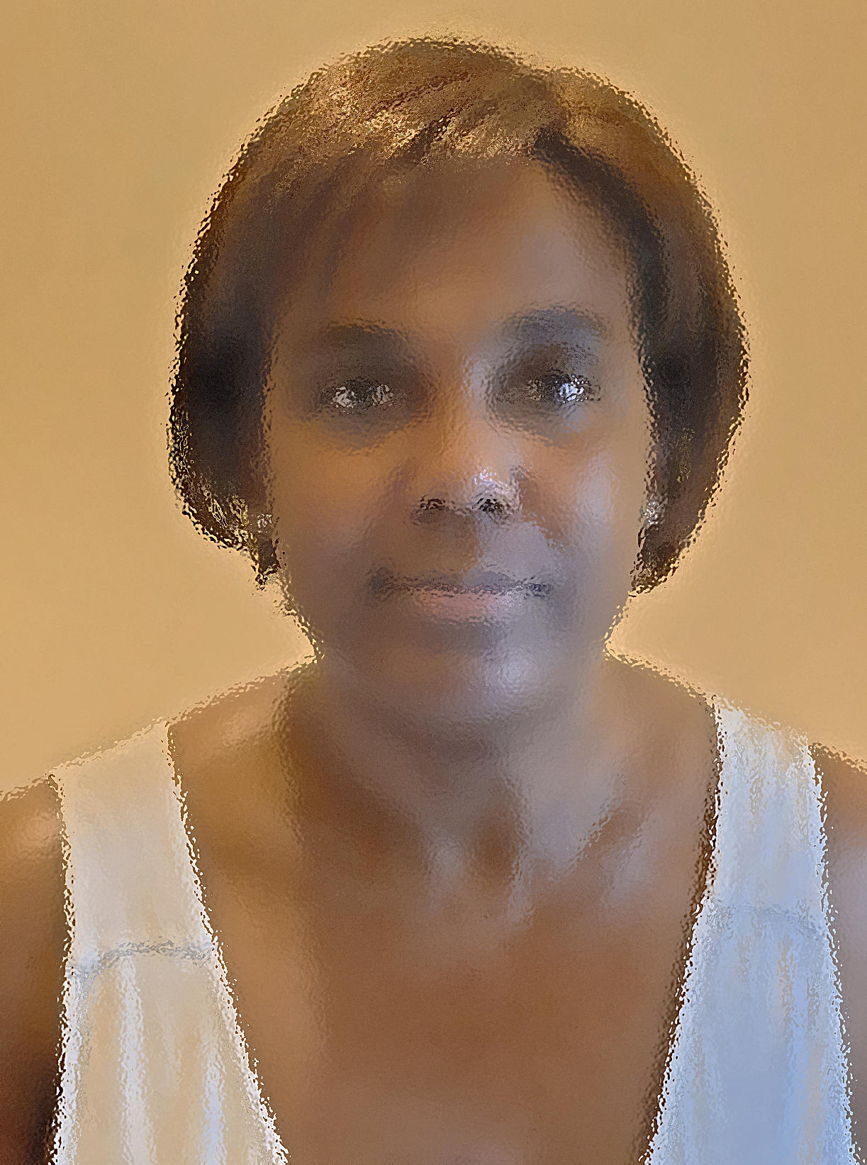
ANN HEALTH AND SAFETY SUPPORT 57yrs old
What do you want the world to know about HTLV?
HTLV affects you without warning
It’s more common than you think
How you could contract the virus
Some of the symptoms are common with other illnesses such as arthritis and therefore can be mis-diagnosed
What do you wish you knew about HTLV before you were affected personally?
How common it is
How prevalent it is in my culture
What are the key symptoms
What would you say to someone newly diagnosed?
That your mindset will affect and is key in how you deal with the virus
It is not the end of the world even though it might feel that way
Your life may change but a lot can remain the same
The virus affects everyone differently so try not to compare yourself with others who have the virus
What do you wish all medical staff would know?
DO NOT confuse HTLV with HIV
To at least know the basics (fast facts) of the HTLV virus
For your local Doctor to spot enough symptoms to warrant referring you to a specialist for further examination
What has been the best support you've received?
Regular monitoring at the HTLV Clinic. It is so reassuring to know there is a clinic that is dedicated to and specialising in the virus
My local Doctor’s Surgery
Family and friends
Line Managers at work
Why is it important for you to raise awareness of HTLV?
Not enough people know what it is
So if it is common place in certain cultures, then Doctors can warn about this as they do with Stroke, Diabetes, Hypertension etc.
So it will not be confused with or mistaken for the HIV Virus
So it appears in important documentation. E.g. medical/travel insurance
So family member are able to understand what you and they are up against

